Slide 1
Hadoop on HDInsight Technical Overview Nishant Thacker Technical Product Manager Microsoft

Slide 2

HDInsight on Linux (HDI): Technical Overview
Agenda
Apache Hadoop
Apache HCatalog
Apache Hive
Apache Pig
Apache HBase
Apache Storm

Slide 3
Hadoop
Agenda
Overview
MapReduce
Tez
YARN
HDFS

Slide 4
Hadoop – What is it?
A highly reliable, distributed and parallel programming framework for analyzing big data
An Java-based, open sourced, Apache project
Capable of running on variety of hardware platforms, including clusters of commodity hardware
Is tolerant to failures of nodes, software components, network
Scales with the cluster
The Hadoop core consists of:
A scalable, reliable file system (HDFS)
A framework that enables development of programs based on MapReduce (MR) or Directed Acyclic Graph (DAG) model
YARN, a distributed resource manager that allocates and controls access to the resource of the cluster manager
In addition to the core Hadoop has a rich ecosystem that supports SQL/NoSQL, Streaming, Real-time and Interactive applications.
Hadoop Core
MapReduce
Tez
(data processing framework)
YARN (cluster resource manager)
HDFS
(redundant, reliable storage)

Slide 5
MapReduce Component: Job Tracker
The JobTracker service farms out MapReduce tasks to specific nodes in the cluster (ideally the nodes that have the data, or at least are in the same rack).
Client applications submit jobs to the Job tracker.
The JobTracker talks to the NameNode to determine the location of the data
The JobTracker locates TaskTracker nodes with available slots at or near the data
The JobTracker submits the work to the chosen TaskTracker nodes.
When the work is completed, the JobTracker updates its status.
TaskTracker nodes are monitored.
If they do not submit heartbeat signals often enough, they are deemed to have failed and the work is scheduled on a different TaskTracker.
A TaskTracker will notify the JobTracker when a task fails
The Job Tracker may resubmit the job elsewhere, mark that specific record as something to avoid and even blacklist the TaskTracker as unreliable.
Client
Master Nodes
JobTracker
NameNode
Slave Nodes
TaskTracker
TaskTracker
TaskTracker
Tasks
Tasks
Tasks
Tasks
Tasks
Tasks
Tasks
Tasks
Tasks
Tasks
Tasks
Tasks
Tasks can be Map or Reduce tasks
HDFS component DataNodes are not shown. They are usually be on the same servers as TaskTrackers

Slide 6
MapReduce Component: Task Tracker
A TaskTracker is a node in the cluster that accepts tasks - Map, Reduce and Shuffle operations - from a JobTracker.
Every TaskTracker is configured with a set of slots, the number of tasks that it can accept. When the JobTracker tries to find somewhere to schedule a task it first looks for an empty slot on the same server that hosts the DataNode containing the data, and if not, it looks for an empty slot on a machine in the same rack.
The TaskTracker spawns a separate JVM processes to do the actual work; this is to ensure that process failure does not take down the task tracker. The TaskTracker monitors these spawned processes, capturing the output and exit codes.
When the process finishes, successfully or not, the tracker notifies the JobTracker.
TaskTrackers also send out heartbeat messages to the JobTracker, usually every few minutes. These message also inform the JobTracker of the number of available slots, so the JobTracker can stay up to date with where in the cluster work can be delegated.
Client
Master Nodes
JobTracker
NameNode
Slave Nodes
TaskTracker
TaskTracker
TaskTracker
Tasks
Tasks
Tasks
Tasks
Tasks
Tasks
Tasks
Tasks
Tasks
Tasks
Tasks
Tasks
Tasks can be Map, Reduce or Shuffle tasks
HDFS component DataNodes are not shown. They are usually be on the same servers as TaskTrackers

Slide 7
Hadoop MapReduce Concept
Divide a large problem into sub-problems.
Programming framework (library and runtime) for analysing datasets stored in HDFS
………
Map()
Perform the same function on all sub-problems.
Composed of user-supplied Map and Reduce functions:
Do work()
Do work()
Do work()
Map() - subdivide and conquer
Combine the output from all sub-functions.
Reduce()
Reduce() - combine and reduce cardinality
Output
Notes:
Talk Track: Let’s go over the main concepts for MapReduce. Hadoop MapReduce is a programming and runtime framework for analyzing datasets stored in HDFS. It’s designed to let you write applications that rapidly process vast amounts of data in parallel on a large cluster of compute nodes.
MapReduce jobs are composed of user-supplied Map and Reduce functions. Map functions take a divide and conquer approach to processing data as fast as possible. Reduce functions combine and reduce cardinality. The MapReduce framework provides all the “glue” and coordinates the execution of the Map and Reduce jobs on the cluster.
Map functions take a large problem and divide it into sub-problems and perform the same function on all sub-problems. Reduce functions perform the Combine process, which takes the output from all sub-problems and creates a result set out of it. Often this output is in the form of a delimited text file that can be easily consumed by the speed and serving layers.
Key Points:
Map: Subdivide tasks into smaller sub-tasks, and sends across various reducers
Reduce: Combine the sub-tasks and reduce cardinality
References:
Using MapReduce with HDInsight: http://www.windowsazure.com/en-us/manage/services/hdinsight/using-mapreduce-with-hdinsight/

Slide 8
MapReduce: How it works
Hadoop divides the input file into splits and assign every split to different mapper.
Locally Hadoop reads the split line-by-line and call map() for very line, passing it as key/value parameters
The mapper emits other intermediate key/value pairs
All the intermediate values for a given intermediate key are combined together into a list.
The list is given to one or more Reducers.
All values associated with a particular intermediate key are guaranteed to go to the same Reducer
The intermediate keys, and their value lists, are passed to the Reducer in sorted key order – This step is known as the ‘shuffle and sort’
Hadoop calls reduce() on every line of the input
The Reducer outputs zero or more final key/value pairs. These are written to HDFS
HDFS
Input Data File
Host
Host
Mapper
Mapper
…
Data Partition 1
Data Partition 2
Data Partition 3
Data Partition 1
Data Partition 2
Data Partition 3
Host
Host
Reducer
Reducer
Output File
Output File
HDFS

Slide 9

HDFS – What is it?
A scalable, reliable and highly distributed file system to store structured and unstructured data
A open-source Apache Project
Optimized for high throughput of data access rather than low latency of data access.
Data is organized into files and directories
Files are divided into uniform size block and divided across cluster nodes
Data blocks are re-balanced (using different models)
Block placement is exposed to application so that computation can be place close to the data (enables the “Move the Computation to the Data” philosophy”)
Blocks are replicated (default 3) to handle failures and for performance
Checksums for corruption detection and recovery
POSIX-style permissions and access control model

Slide 10
HDFS: Reading and Writing Data
Reading a Block
Name Node
Adding a Block
Client
getLocations
getFileinfo
create
addBlock
Client
Name Space State
Block Map
Read
Write
Data Node
Data Node
Data Node
Data Node
Replicate
Replicate

Slide 11
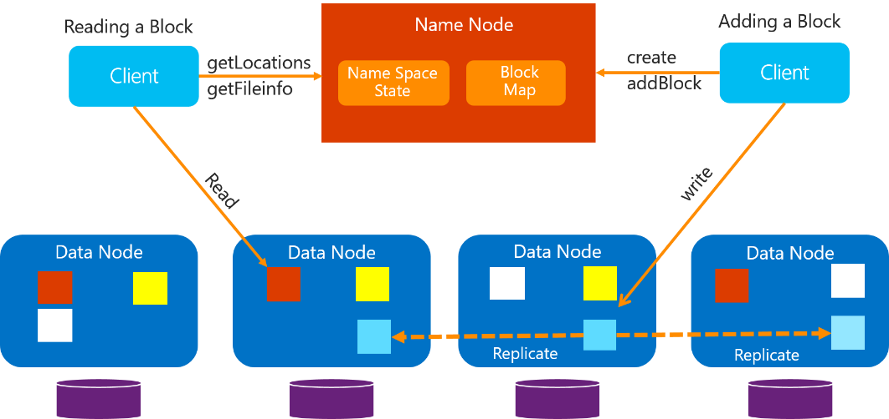
HDFS Components
NameNode
Keeps all namespaces in memory
Maintains metadata (i.e. “inode”)
Monitors Data Node health
Replicates missing blocks
Maintains mapping of list of blocks + locations
Maintains Authorization and Authentication data
Manages Checkpoint & journal namespace changes
Data Node
Serves data blocks directly to customers
Handles block storage on multiple volumes & block integrity
Periodically sends heartbeats and block reports to NameNode
Stores Blocks as underlying OS’s file

Slide 12
Apache YARN – What is it?
Is cluster resource manager for Hadoop that enables a variety of applications types including MapReduce and Tez as well as non-MapReduce applications
YARN – Yet Another Resource Negotiator (common concept in High Performance Computing Architectures)
Manages a set of resources (CPU, Memory, Disk) among a set of competing applications.
Applications using YARN do not have to worry about other applications running on the same cluster
YARN takes cares of common issues such in running apps on shared resources including, scheduling, contention, starvation, pre-emption etc.
Is a general-purpose resource manager. Support variety of application types:
Distributed Shell, Impala, Apache Giraph, Spark, MapReduce
Others: http://wiki/apache.org/Hadoop/PoweredByYarn
Open source, Apache Project
Is now part of most popular Hadoop Distributions
Hadoop 0.20
HDFS
MRv1
Hadoop Common
Hadoop 2.0 (pre-GA)
HDFS
MRv2/YARN
Hadoop Common
Hadoop 2.0 (pre-GA)
HDFS
MRv2
YARN
Hadoop Common

Slide 13
YARN – Motivation
Drawbacks of the pre-YARN architecture
Jobs scheduling, Resource management and data processing was all inflexibly coupled (MR)
Inflexible “slots” were configured on node – Map or Reduce, but not both.
Underutilization of cluster when more map or reduce tasks are running
Cannot share resources with non-MR applications on Hadoop Cluster (e.g. Impala, Giraph)
One JobTracker per cluster limited scalability (max of 4000 nodes)
How YARN addresses the limitations
No slots. Node have resources—memory and CPU cores– which are allocated to applications when requested.
Support both MR and non-MR applications running on the same cluster
Most Job Tracker functions moved to Application Master– one cluster can have many Application Masters
MapReduce 2
MapReduce 1
MR API
Unified API
Data Processing Framework
Data Processing Framework
YARN
Resource Management & Job Scheduling
YARN API
Resource Management & Job Scheduling

Slide 14
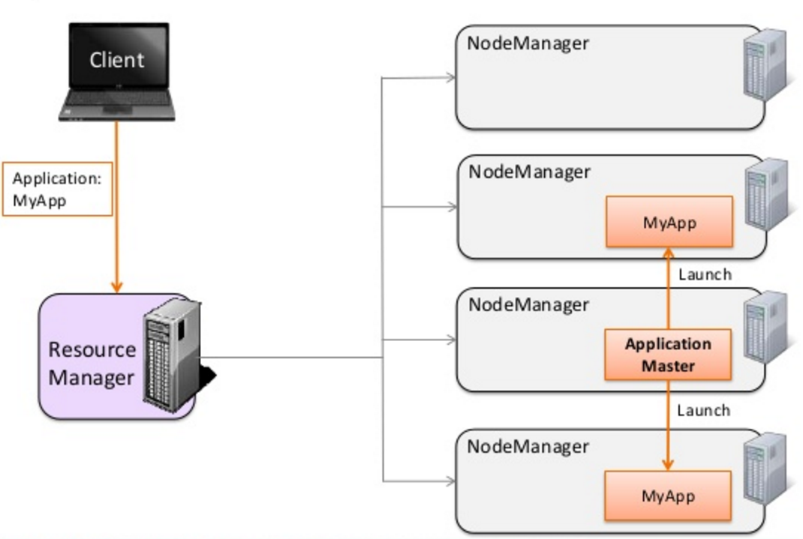
YARN: Cluster Components
Resource Manager
Runs on the master node
Arbitrates system resources between competing apps
Node Manager
Runs on the slave nodes
Communicates with the RM
Containers
Where the application code runs.
Allocated by the RM upon request
Consists of some amount of resources (CPU, Memory)
Application Master
One per application
Runs in a container.
Requests containers on run application tasks

Slide 15
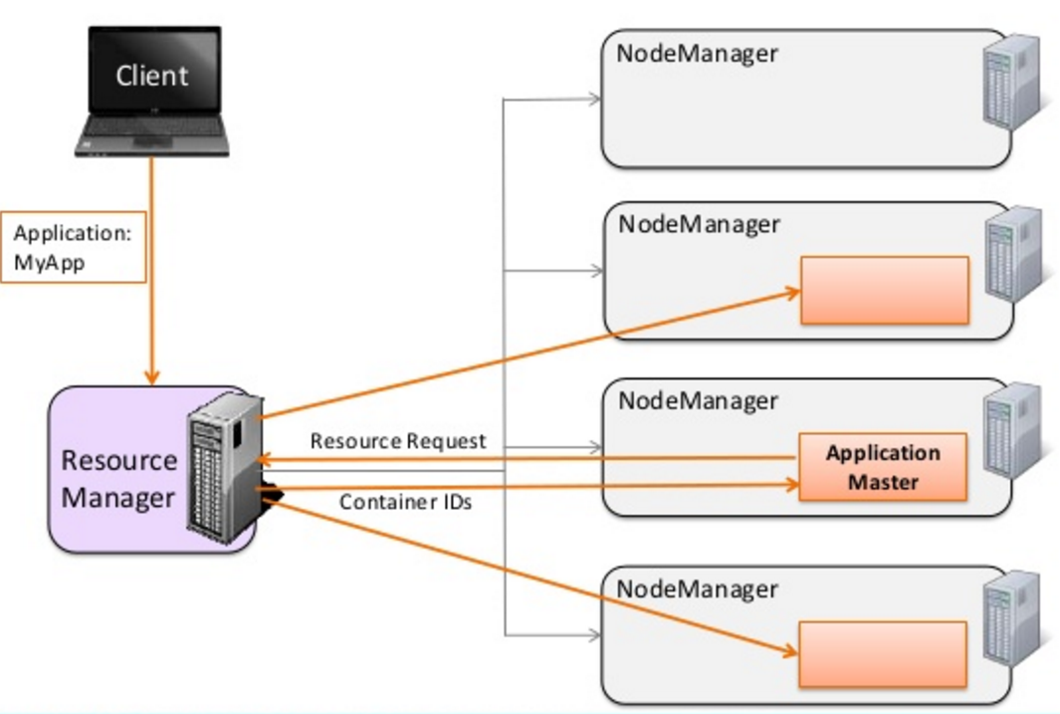
YARN: Process Flow
Client ask the RM for resources.
RM asks a Node Manager to launches an instance of the AM.
After launch, AM requests resources from the RM. A Resource Request includes
Priority (within this application, not between applications)
Memory (MB) and CPU (number of cores)
Number of containers
RM communicates with the Node Mangers to allocate the desired number of containers somewhere in the cluster
RM passes the container IDs to the AM.
AM request the Node Manager to launch the application processes by passing on the following information:
The Container ID
Commands to start the application
Environment information,
Application Binary etc.
After the application code finishes execution, the AM informs the RM.
RM asks the Node Manager to deallocate the containers and free up the resources.

Slide 16
Apache Tez – What is it?
A YARN-based framework for running high performance batch and interactive data processing applications in Apache Hadoop.
What is it?
Developer API and an execution framework
Programming model that expresses computation as a dataflow graph (DAG)
Uses YARN for cluster resource management
Supported by Hadoop ecosystem projects (Pig, Hive, Cascading).
Benefits
Much faster than MapReduce for many applications.
Supports a wider range of applications than MR
Provides apps greater control over executions
Script
SQL
Java
Engines
Others
Others
Pig
Hive
Cascading
Hbase
Accumulo
Storm, Solr
Spark
Engines
ISV
Engines
Tez
Tez
Tez
Tez
YARN: Data Operation System
(Cluster Resource Management)
HDFS
(Hadoop Distributed File System)

Slide 17

Tez DAG Components
Tez defines a simple Java API to express a DAG of data processing.
Tez models data processing as a dataflow graph, with the graph vertices representing application logic and its edges representing movement of data.
The API has three components:
DAG – defines the overall job. The user creates a DAG object for each data processing job.
Vertex – defines the user logic and the resources & environment needed to execute the user logic. The user creates a Vertex object for each step in the job and adds it to the DAG
Edge – defines the connection between producer and consumer vertices. The user creates an Edge object and connects the producer and consumer vertices using it.

Slide 18
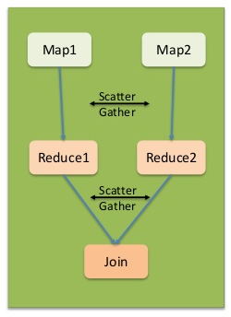
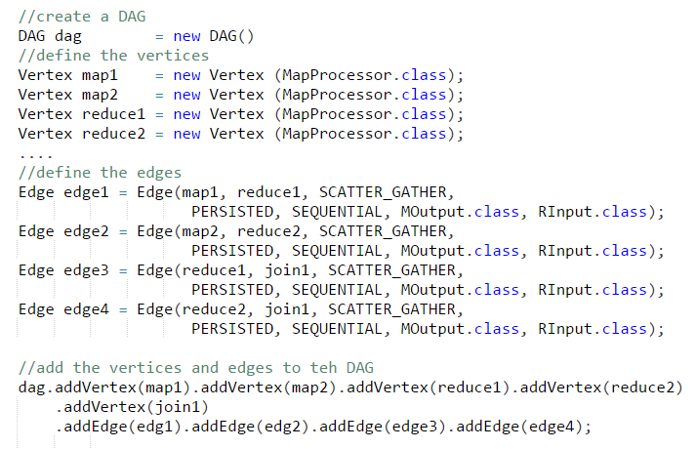
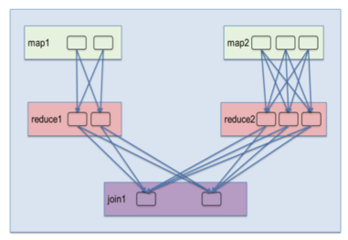
Tez: DAG Execution
Code (simplified) to create a DAG (using Java API)
Mapreduce would be expressed with the scatter-gather, sequential and persisted edge properties.
‘Logical’
Dataflow
Graph
Tez handles expanding the logical graph at runtime to perform the operations in parallel using multiple tasks.
The diagram shows a runtime expansion in which the first M-R pair has a parallelism of 2 while the second has a parallelism of 3. Both branches of computation merge in the Join operation that has a parallelism of 2
Notes:
http://hortonworks.com/blog/expressing-data-processing-in-apache-tez/

Slide 19

Tez – How it improves performance?
The performance benefits of expressing data processing as a DAG are:
Eliminates replicated write barrier between successive computations
Eliminates job launch overhead of workflow jobs
Eliminates extra stage of map reads in every workflow job
Eliminates queue and resource contention suffered by workflow jobs that are started after a predecessor job completes
Better locality because the engine has the global picture
Runtime optimizations: Application can modify the DAG at runtime to optimize execution. Applications can:
Change task concurrency,
Change task scheduling and
Change DAG edges
MapReduce
Tez
Mapper
Mapper
Mapper
Mapper
Mapper
Mapper
Mapper
Mapper
Reducer
Reducer
Mapper
Mapper
Reducer
Reducer
Reducer
HDFS
Reducer
Mapper
Mapper
HDFS
Reducer
HDFS
Reducer
Mapper
Mapper
Reducer
Reducer

Slide 20







HDInsight – What is it?
A standard Apache Hadoop distribution offered as a managed service on Microsoft Azure
Based on the Hortonworks Data Platform (HDP)
Provisioned as clusters on Azure. Clusters can run on Windows or Linux Servers.
Offers a capacity-on-demand, pay-as-you-go pricing model
Integrates with:
Azure Blob Storage and Azure Data Lake Store for the Hadoop File System (HDFS)
Azure Portal for management and administration
Visual Studio for application development tooling
In addition to the core, HDInsight supports the Hadoop Ecosystem
Hive

Slide 21


HDInsight: How/Where it fits?
Azure Data Lake
Analytics
Partners
analytics service
clusters (HDInsight)
Integrated analytics and storage
Fully Managed
Easy to use – “dial for scale”
Proven at scale
Analyze data of any size, shape or speed
Open-standards based
Hortonworks
Cloudera
U-SQL
MapR
YARN
HDFS
Applications
Devices
Sensors
Social
Store
Relational
Web
Clickstream
Video

Slide 22
HDInsight cluster architecture
HTTP traffic
ODBC/JDBC
WebHCatalog
Oozie
Ambari
Azure Data Lake Store
Azure VNet
Secure gateway
AuthN
HTTP Proxy
Highly available Head nodes
Worker nodes
x

Slide 23
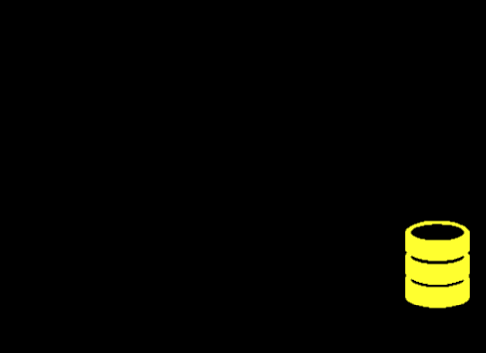
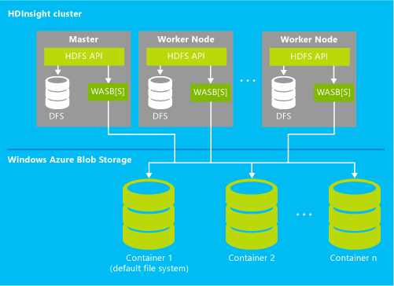
Benefits of Hadoop as a Azure Service
HDInsight clusters can be configured in just a few minutes
Through the HDFS interface, HDInsight can operate directly on data stored in Azure Blob Storage or Azure Data Lake Store. A separate and dedicated HDFS cluster is not required. Benefits include:
Data reuse and sharing
Elastic scale-out
Lower data storage costs
Protection against data loss
High Performance: The high-speed flat networks in Azure datacenters provide fast access between the virtual machines in the cluster and Azure Blob Storage or Azure Data Lake Store so data movement is very efficient
Commission and decommission HDInsight clusters at will
Visualize the data stored in Hive tables using Excel and the set of add-ins, such as Power Query, Power View, PowerPivot, and Power Map.
HDInsight Cluster
Master
Worker Node
Worker Node
HFDS API
HFDS API
HFDS API
…
WebHDFS
WebHDFS
WebHDFS
DFS
DFS
DFS
Azure Data Lake Storage
Container 1
Container 2
Container 3

Slide 24
HCatalog
Agenda
HCatalog Essentials
Hcatalog Components

Slide 25

Hcatalog: What is it?
Is a metadata and table management system for the Hadoop platform that enables sharing
HCatalog displays data from RCFile format, text files, or sequence files in a tabular view.
Is a table management layer that exposes Hive metadata (as REST APIs) to other Hadoop applications.
HCatalog’s table abstraction presents users with a relational view of data in HDFS
Ensures users need not worry about where or in what format their data is stored.
Benefits:
Frees the user from having to know where the data is stored, with the table abstraction
Enables notifications of data availability
Provides visibility for data cleaning and archiving tools
Streaming
HCatalog
ORC
File
Sequence File
Text File
Custom Format

Slide 26
HCatalog: How it works
HCatalog supports reading and writing files in any format for which a Hive SerDe (serializer-deserializer) can be written
To use a custom format, you must provide the InputFormat, OutputFormat, and SerDe.
HCatalog is built on top of the Hive metastore and incorporates components from the Hive DDL.
The HCatalog interface for Pig consists of HCatLoader and HCatStorer, which implement the Pig load and store interfaces respectively.
The HCatalog interface for MapReduce — HCatInputFormat and HCatOutputFormat — is an implementation of Hadoop InputFormat and OutputFormat.
Hcatalog Data Model and hierarchy is the similar to the HBase model.
HCatalog facilitates interoperability and enables sharing of data
Oozie
Java MR APIs
Pig
Hive
HCatInputFormat/
HCatOutputFormat
HCatLoader/
HCatStorer
SerDe & Storage Handler
MetaStore
Client
InputFormat/ OutputFormat
Notifications
HBase
MapReduce (YARN)
HCatalog
MetaStore
HDFS
HDFS
Diagram source: Yahoo! Presentation at Hadoop Summit 2014

Slide 27
Hive
Agenda
Hive Essentials
Hive Architecture
HiveQL
Hive Vs RDBMS

Slide 28
Apache HIVE: What is it?
A ‘Data Warehouse’ built using Hadoop for querying and analyzing big data
Enables you to view big data as ‘Tables’ and use familiar SQL-like operations on them.
Lets you impose a table-like view on big data
However, not a substitute for full-fledged RDBMS.
Hive tables can be queried using HiveQL, a SQL-like query language
HiveQL queries are eventually executed as MapReduce or Tez programs by Hadoop
Hive
HiveQL
Table View
HDFS

Slide 29
Hive: Query Execution Components
User issues SQL query
CLI
JDBC/ODBC
1
Web UI
Hive SQL
Query converted to Tez and executed on Hadoop
Hive parses and plans query
YARN job
Compiler
HiveServer2
Hive
Optimizer
NodeManager
3
2
Hadoop
Hive
Metastore DB
Executor
Notes:
This topic explores how you can get data into your Big Data solution. It describes several different but typical data ingestion techniques that are generally applicable to any Big Data solution. These techniques include ways to handle streaming data and for automating the ingestion process. While the focus is primarily on Microsoft Azure HDInsight, many of the techniques described here are equally relevant to solutions built on other Big Data frameworks and platforms.
The figure shows an overview of the techniques and technologies covered in this section of the guide.

Slide 30
HiveQL: Execution Flow
ODBC
JDBC
Hive web interface (HWI)
Command line interface (CLI)
Hive clients send HiveQL queries to the driver
The driver sends query to the compiler for parsing and syntax checking.
The compiler gets the metadata from the store and returns a execution plan to the driver.
The driver sends the execution plan to the execution engine.
The execution engine submits the plan as a MR job to be executed by Hadoop. After Hadoop completes execution, the execution engine gets the results which are returned to the driver, which in turn returns the results to the Hive clients.
The execution engine can execute metadata operations against the Metastore
1
Thrift server
2
1
3
2
Driver
4
Compiler
4
MetaStore
3
5
Execution
5.1
5
5.1
Hadoop / HDFS

Slide 31
Hive Data Organization Hierarchy
Database
Table
Table
Table
Partition
Partition
Partition
Partition
Partition
Partition
Buckets / Clusters
Buckets / Clusters
Buckets / Clusters
Buckets / Clusters
Buckets / Clusters
Buckets / Clusters
Notes:
Databases: Namespaces that separate tables and other data units from naming confliction.
Tables: Homogeneous units of data which have the same schema. Partitions: Each Table can have one or more partition Keys which determines how the data is stored. Partitions - apart from being storage units - also allow the user to efficiently identify the rows that satisfy a certain criteria. For example, a date_partition of type STRING and country_partition of type STRING. Each unique value of the partition keys defines a partition of the Table. For example all "US" data from "2009-12-23" is a partition of the page_views table. Therefore, if you run analysis on only the "US" data for 2009-12-23, you can run that query only on the relevant partition of the table thereby speeding up the analysis significantly. Note however, that just because a partition is named 2009-12-23 does not mean that it contains all or only data from that date; partitions are named after dates for convenience but it is the user's job to guarantee the relationship between partition name and data content!). Partition columns are virtual columns, they are not part of the data itself but are derived on load.
Buckets (or Clusters): Data in each partition may in turn be divided into Buckets based on the value of a hash function of some column of the Table. For example the page_views table may be bucketed by userid, which is one of the columns, other than the partitions columns, of the page_view table. These can be used to efficiently sample the data.
Note that it is not necessary for tables to be partitioned or bucketed, but these abstractions allow the system to prune large quantities of data during query processing, resulting in faster query execution.

Slide 32
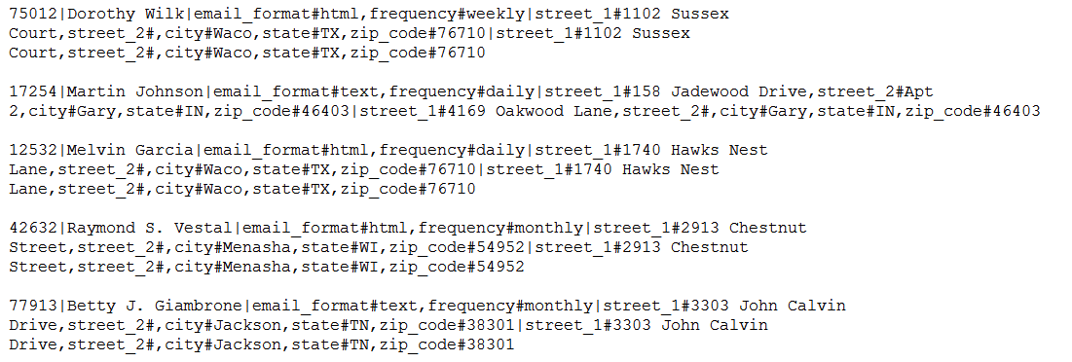
Sample Data – Customers File
Customer Id
Customer Name
Email Preferences
Shipping Address
Billing Address

Slide 33
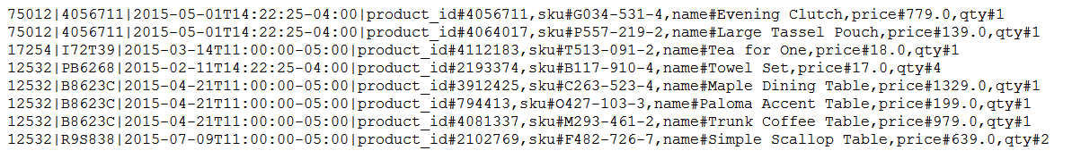
Sample Data – Orders File
Customer Id
Order Data and Time
Order Id
Product Details

Slide 34
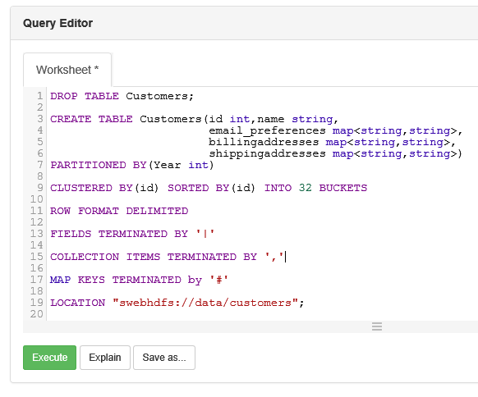
Hive Table Creation
Hive supports complex types such as “map”
Internal Tables | Manage/control the data. If an internal table is dropped, the associated data is deleted. Default.
External Tables | Do not manage/control the data. If an external table is dropped the associated data is not deleted.
LOCATION | Location of the data can be specified with LOCATION keyword Location can be a HDFS folder that already has the data. Or data can be added later to an empty folder. If not specified, default is: /hive/warehouse/
Multiple Views | Multiple tables can point to the same data
HDInsight Hive Tables can directly point to Azure Data Lake Store files
* Order table creation is shown in notes sections
Notes:
DROP TABLE Orders;
CREATE TABLE Orders(id int,orderid string,orderdate string,items map<string,string>)
ROW FORMAT DELIMITED
FIELDS TERMINATED BY '|'
COLLECTION ITEMS TERMINATED BY ','
MAP KEYS TERMINATED by '#';

Slide 35
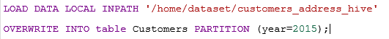

Loading Data into Hive Tables
Options
Load local data | LOAD DATA LOCAL INPATH ... INTO TABLE … hadoop dfs –put ‘local source’ ‘destination’
Load data from other Hive tables | INSERT INTO TABLE ‘destination-hive-table’ SELECT ‘select-statement’ FROM ‘source-hive-table’
Insert values directly | INSERT INTO TABLE ‘tablename’ VALUES (row1_values), (row2_values), ….
Local File
/hive/warehouse/customer
‘/home/dataset/customers_address_hive’
Hadoop/HDFS
* Loading data into orders table is shown in the notes sections
Notes:
LOAD DATA LOCAL INPATH '/home/snapssh/dataset/customers_orders_hive' OVERWRITE INTO table Orders;
Note that all the data has been loaded into the year=2015 partition. Now the year can be used in queries for partition elimination as if it was a regular table column.

Slide 36
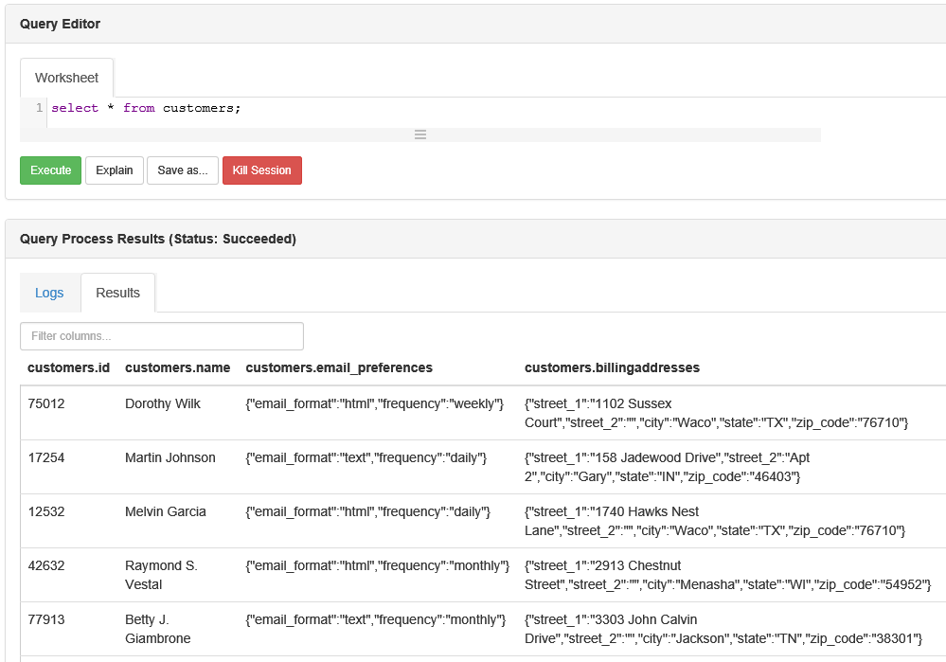
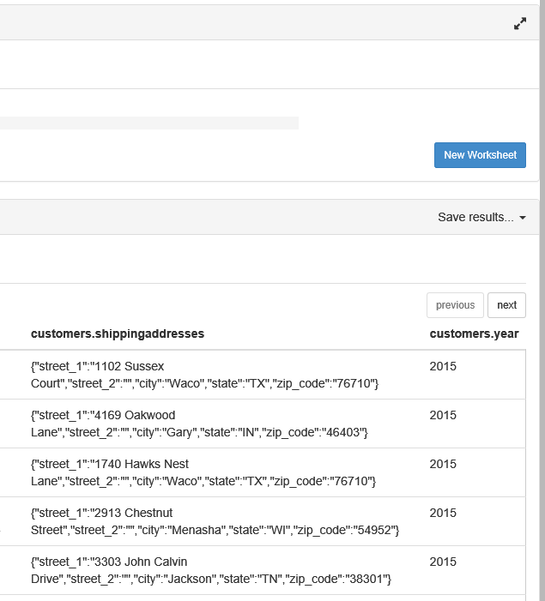
Customers Table

Slide 37
HiveQL Overview
SQL-like syntax: SELECT … FROM … WHERE
ALL and DISTINCT
Support for Partitioning
GROUP BY
SORT BY, ORDER BY, CLUSTER BY, DISTRIBUTE BY
JOINs: LEFT, RIGHT, FULL, OUTER, LEFT SEMI, CROSS JOIN
Built-in: Operators, Functions, Aggregate Functions
User Defined Functions (UDFs)
Support for Subqueries
Windowing and Analytics Functions
HiveQL

Slide 38
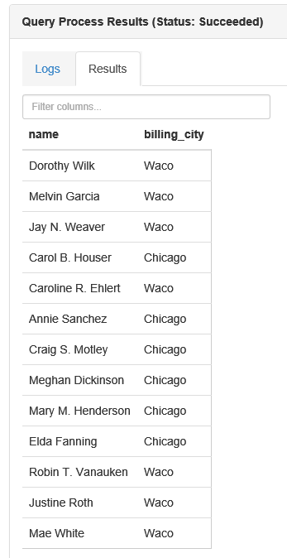
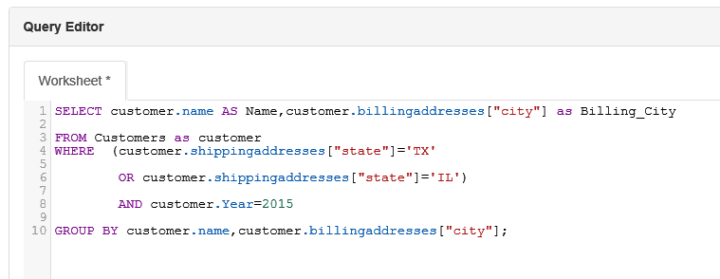
HiveQL
Query: Find name and billing city of customers with shipping addresses in ‘TX’ or ‘IL‘. Group by City.

Slide 39
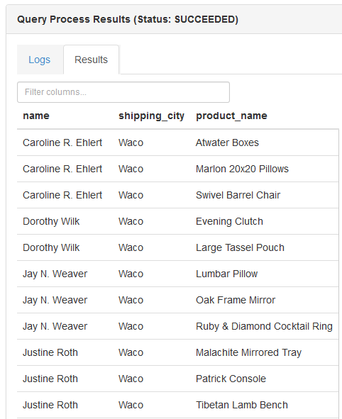
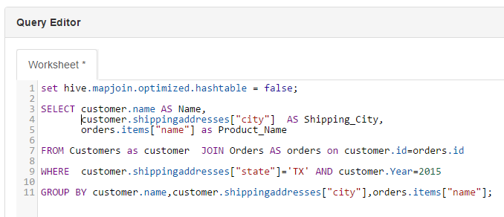
HiveQL
Query: Find names of products purchased by customers whose shipping address is in Texas.

Slide 40
HDI on Linux: HiveQL Execution Choices
Tool | Interactive Shell | Batch Processing | Client OS
Hive View |  |  | Any (browser based)
Beeline Command (from an SSH session) |  |  | Linux, Unix, Mac OS X, or Windows
Hive Command (from an SSH session) |  |  | Linux, Unix, Mac OS X, or Windows
Curl |  |  | Linux, Unix, Mac OS X, or Windows
HDInsight tools for Visual Studio |  |  | Windows
Windows PowerShell |  |  | Windows

Slide 41
Comparing RDBMS and Hive
 | RDBMS DW | Hive
Structure | Schema On Write | Schema On Read
Access | SQL | HiveQL
Indexes | Yes | Yes
Updates | Yes | No
Locking | Yes | Table and Partition
Referential Integrity | Yes | No
Query Optimization | Yes | No
Access Pattern | Read and Write many times | Write Once, Read-many-times
OLTP Applications | Yes | No

Slide 42
Recent Hive releases
Stinger
Hive 0.10
Hive 0.13
Hive 0.14 (1.0)
Hive 1.2
BATCH
INTERACTIVE
SUB-SECOND
SQL Enhancements
Read-only Data
Read-only Data
Modify w/Transactions
Optimizer Improvements
Hive QL
Substantial SQL
SQL:2011 Analytics
Improved Performance
MR
MR, Tez
MR, Tez, Spark
Security
Enterprise SQL at Hadoop Scale
Apache Hive Version | RDBMS DW
1.2 | SQL Enhancements Performance and Optimizer Improvements: Security Improvements
0.141 (1.0) | Speed: cost-based optimizer for star and bushy join queries Scale: tempory tables Scale: transactions with ACIDsemantics
0.13 | Speed: Hive on Tez, verctorize query engine & cost-based optimer Scale: dynamic partition loads and smaller hash tables SQL: CHAR & DECIMAL datatypes, subqueries for IN/NOT IN
0.12 | Speed: Vectorized query engine & ORCFile predicate pushdown SQL: Support for VARCHAR and DATE semantics, GROUP BY on structs and unions

Slide 43

Visual Studio tooling
Ships with the Azure SDK
Supported for VS 2012, 2013 and 2015
Enables Hive query authoring, submission and debugging
Navigate Linked Resources
Create Hive Tables
Run Hive Queries
View Hive Jobs
Hive Script Local Validation
IntelliSense Support for Hive (Preview)
Table creation and schema management are also supported

Slide 44
Pig
Agenda
Pig Essentials
Pig Commands

Slide 45
Apache PIG: What is it?
A scripting platform based on MR or Tez for analyzing large data sets stored in HDFS
Makes big data analytics accessible to non-programmers who may find writing MR programs an obstacle
Characteristics:
Extensible: User can create custom functions
Easy to program: Complex tasks involving interrelated data transformations can be simplified and encoded as data flow sequences
Self-optimizing: automatically optimizes execution of Pig jobs
Use cases:
ETL
Itertative data processing
Research on raw data
Script
SQL
Java
Engines
Others
Others
Pig
Hive
Cascading
Hbase
Accumulo
Storm, Solr
Spark
Engines
ISV
Engines
Tez
Tez
Tez
Tez
YARN: Data Operation System
(Cluster Resource Management)
HDFS
(Hadoop Distributed File System)

Slide 46
Apache PIG: Components
Pig Latin
Command based language
Designed specifically for data transformation and flow expression
Execution Environment
The engine in which Pig Latin commands are executed
Supports Local and Hadoop modes
Pig Compiler
Converts Pig Latin to optimized MR or Tez program
Pig Grunt
Pig Server
Pig Latin
Compiler
Execution Engine
Tez
MR
Yarn
HDFS

Slide 47
Apache Pig Latin: Types
int | Signed 32-bit integer
long | Signed 64-bit-integer
float | 32-bit floating point
double | 64-bit floating point
chararray | Character array(string) in Unicode
bytearray | Byte array (blob)
boolean | boolean
tuple | A ordered set of field. e.g: (2,4)
bag | A collection of tuples. e.g: {(2,4), (3, 9)}
map | A set of key value pairs. e.g: [age#32]
Pig Types

Slide 48
Apache Pig: Commands
Load | Read data from the file system
Store | Write data to the file system
Dump | Write output to stdout
Foreach | Apply expressions to each record and generate on or more record
Filter | Apply predicates to each record and remove record where false
Group Cogroup | Collect records with the same key from one or more inputs
Join | Join two or more inputs based on a key
Order | Sort records based on a key
Distinct | Remove duplicate records
Union | Merge two datasets
Limit | Limit the number of records
Split | Split data into 2 or more sets, based on filter conditions
Pig Commands

Slide 49
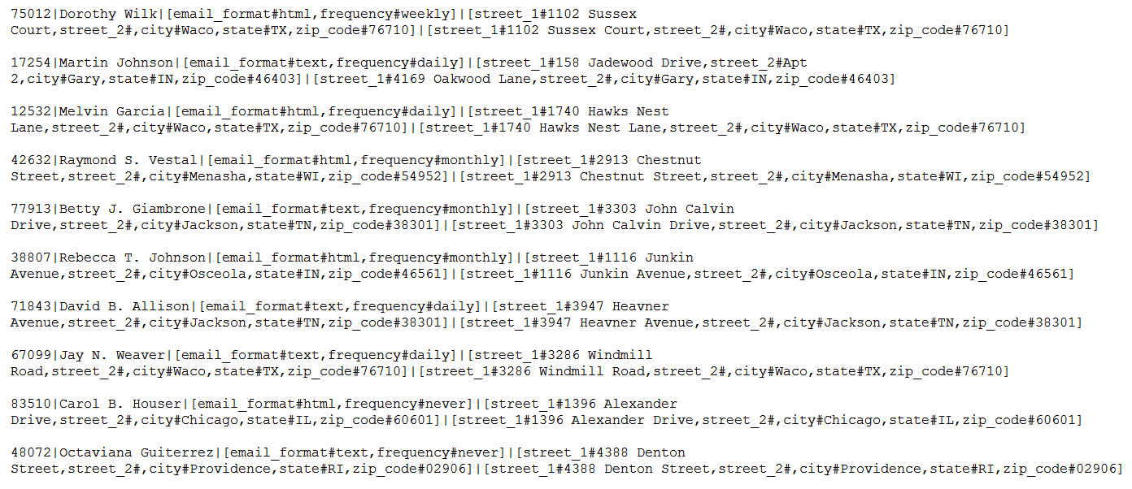
Pig – Sample ‘Customers’ data file

Slide 50
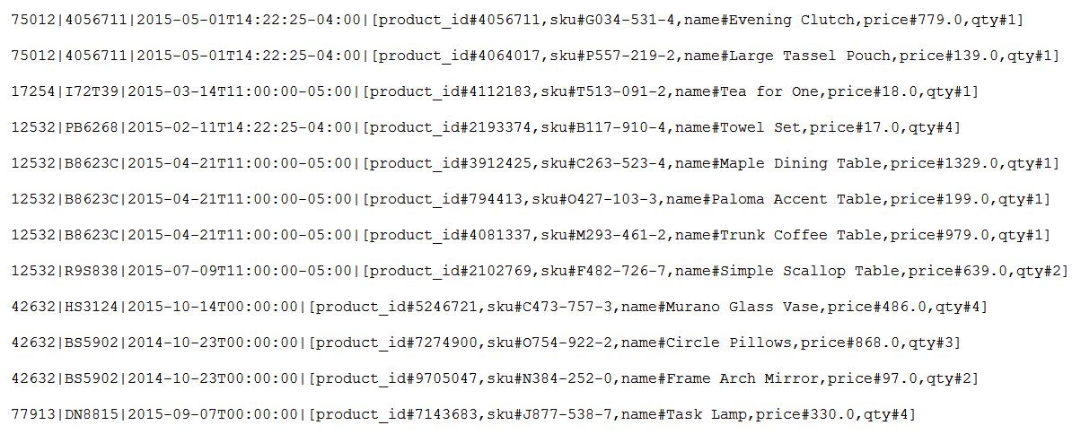
Pig – Sample ‘Orders’ data file

Slide 51
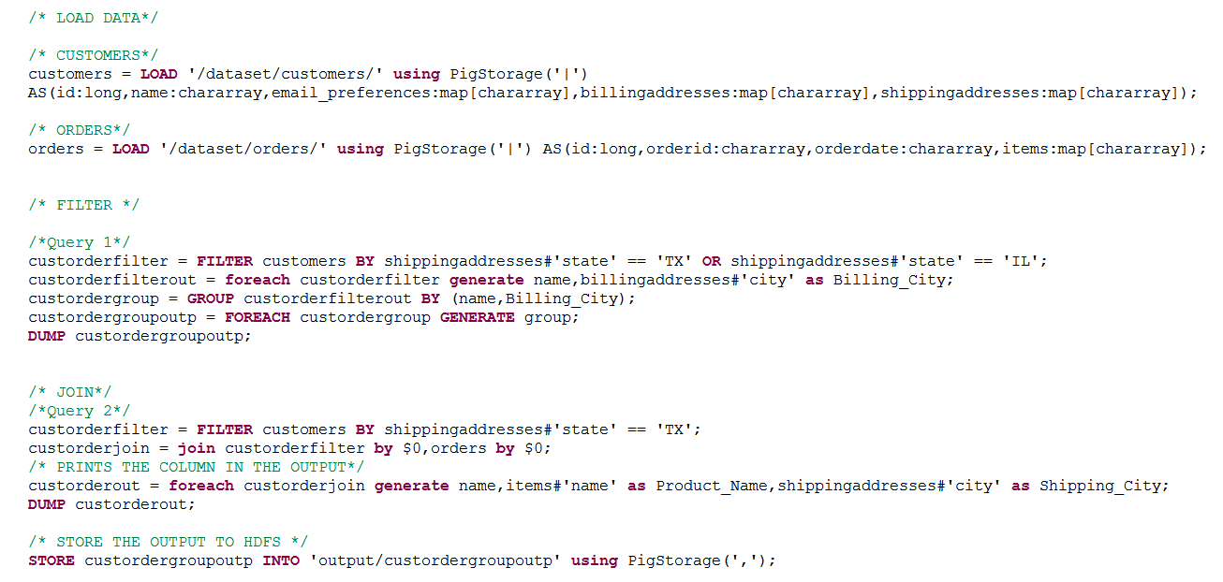
Loading and Querying with Pig

Slide 52
HBase
Agenda
HBase Essentials
HBase Architecture
HBase and RDBMS
HBase and Apache Phoenix

Slide 53

Apache HBase: What is it?
A distributed, columnar, NoSQL database based on Hadoop
Large scale
Linear scalability with automatic partitioning
Billions of rows X millions of columns
Many deployments with 1000+ nodes, PBs of data
Low latencty
Supports Real-time random read & writes
Strongly consistent Read and Writes
Supports Transactions (not fully ACID)
Reliable and Fault Tolerant
Automatic failover in case of server failures
Open source
Modeled after Google’s BigTable

Slide 54
HBase: Data model
Tables are logical collections of rows stored in multiple Regions.
A row is identified by a rowkey. Rowkeys are unique in a table.
Column Families – Data in a row are grouped together as Column Families. Each Column Family has one more Columns.
Columns – A Column is identified by a Column Qualifier that consists of the Column Family name concatenated with the Column name using a colon – example: columnfamily:columnname. Rows within a table can have varied number of Columns or missing columns (sparse tables)
Cell – A Cell stores data and is essentially a unique combination of rowkey, Column Family and the Column.
Table with Customer and Sales Column Families.
Row Key | Customer |  | Sales
Customer Id | Name | City | Product | Amount
101 | John White | Los Angeles, CA | Chairs | $400.00
102 | Jane Brown | Atlanta, GA | Lamps | $200.00
103 | Bill Green | Pittsburgh, PA | Desk | $500.00
104 | Jack Black | St. Louis, MO | Bed | $1600.00
Column Families
The Customer Column Family is made up 2 columns – Name and City
Sales Column Families is made up to 2 columns – Product and Amount.

Slide 55
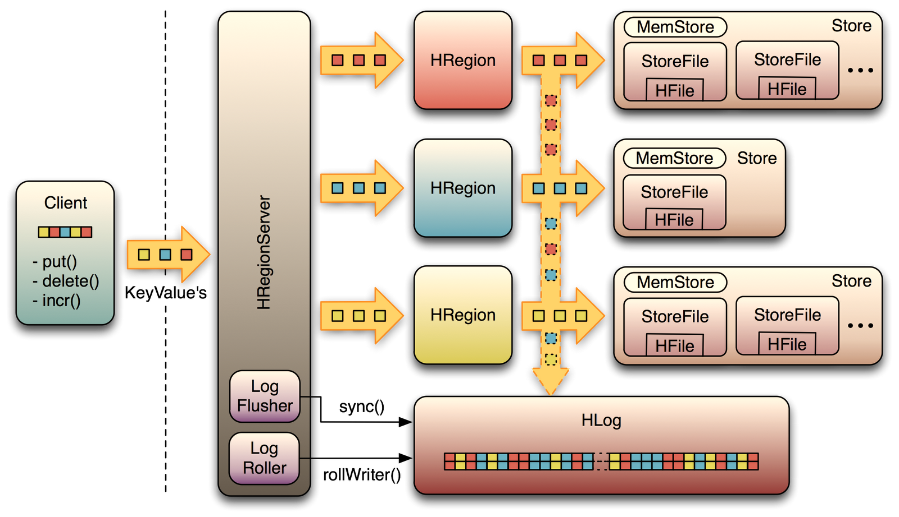
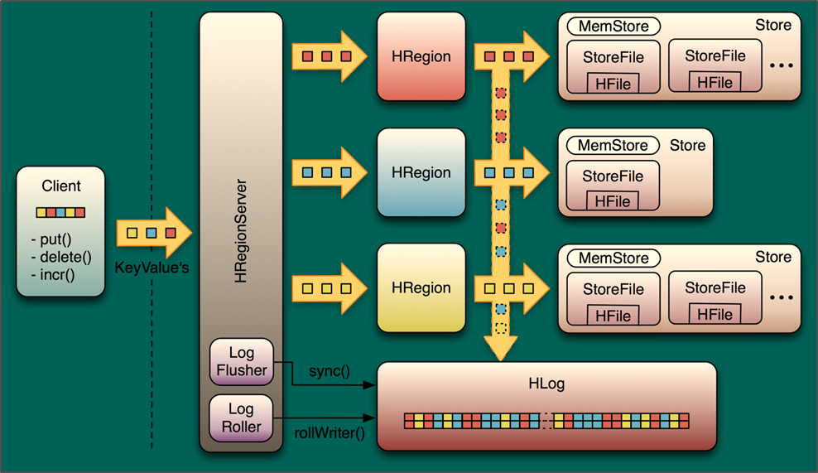
HBase: Key Components
Clients
HMaster
Zookeeper
HRegionServer
HRegion
HLog
MemStore
StoreFile
MemStore
Store
HRegion
StoreFile
StoreFile
HFile
HFile
MemStore
Store
Client
put()
delete()
incr()
HRegion
StoreFile
HFile
HRegionServer
KeyValue’s
MemStore
Store
HRegion
StoreFile
StoreFile
HFile
HFile
Log
Flusher
sync()
HLog
Log
Roller
rollWriter()
HFiles and HLogs are stored in HDFS
Notes:
Diagram source:
http://www.larsgeorge.com/2010/01/hbase-architecture-101-write-ahead-log.html

Slide 56
HBase Key Components: Overview
HMaster
Responsible for Admin Operations
Managers and Monitors the cluster
Assigns Regions to Region Servers
Controls Load balancing and failover
HRegionServer
Hosts and manages regions.
Splits the regions automatically
Handles read/write requests
Communicates with clients directly
HRegions
Consists of a Memstore and one Store per ColumnFamily.
Each store may have multiple StoreFiles
HBase
A write-ahead Log, one per HRegionServer. All changes are recorded in this log. Implemented as a Hadoop sequence file that stores records as sets of key/value pairs
HLog
StoreFile
The data lives in StoreFiles. There are multiple StoreFiles per store.
StoreFiles are implemented as HFiles (permit random read-write access)
Memstore
A in-memory cache, one per Store. All changes are first stored in the cache and then written to persistently to the StoreFile asynchronously

Slide 57
HBase: Object Hierarchy
Table
HBase Table
Region
Regions for the table. HBase scales by having regions across many servers.
Store
Store per ColumnFamily for each region
MemStore
Memstore for each store for each region per table
StoreFile
StoreFiles for each store for each region for the table
Block
Blocks within a StoreFile within a Store for each Region for the table

Slide 58
Concept: Regions, Rows and Partitioning
Rows are distributed/partitioned among multiple region
Each region holds a range of keys
At first there is only one Range. When full HRegionServer splits the Range and redistributes the Rows.
Servers can have 10 to 1000 regions with 1 to 2 GB per region.
Benfits of splitting data into regions:
Fast recovery when a region fails.
Load balancing when a server is overloaded as regions may be moved between server.
Splitting is done asynchronously while data is being read.
Splitting is automated; no manual intervention.
Table A
Region Server 7
a
b
c
d
e
f
g
h
j
k
l
m
n
o
p
Table A, Region 1
Table A, Region 2
Table G, Region 1070
Table L, Region 25
Region 1
Region 2
Region Server 86
Table A, Region 3
Table C, Region 30
Table F, Region 160
Table F, Region 776
Region 3
Region Server 367
Table A, Region 4
Table C, Region 17
Table E, Region 52
Table P, Region 1116
Region 4
Rows of table A is horizontally split into 4 regions.
Region 1 spans, RowKeys ‘a’ thru ‘d’
Regions are hosted on different Region Servers.
Region Server 86 host Region 3 of Table A, Region 30 of Table C etc.
The placement of regions may change as servers are add/removed, servers fail, data is added/removed etc.

Slide 59

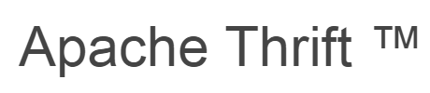
HBase Access API: Insert, Read, Delete Data
Operation | API / Command
Insert or Update Data | You can insert/add new data or update existing cells using the ‘put’ command or ‘add’ command.
Read Data | To read data, use: ‘get’ command to get a single row of data. You can get the entire row or only the specified columns ‘scan’ command to fetch the entire table or only rows matching the specified ‘RowKeys’
Delete Data | To delete data, use: ‘delete’ command to delete a specific cell. ‘deleteall’ to ‘delete’ all the cells of a row
HBase Rest Interface
Web Application
Cluster Boundary
Thrift/REST Gateway
HBase Client

Slide 60
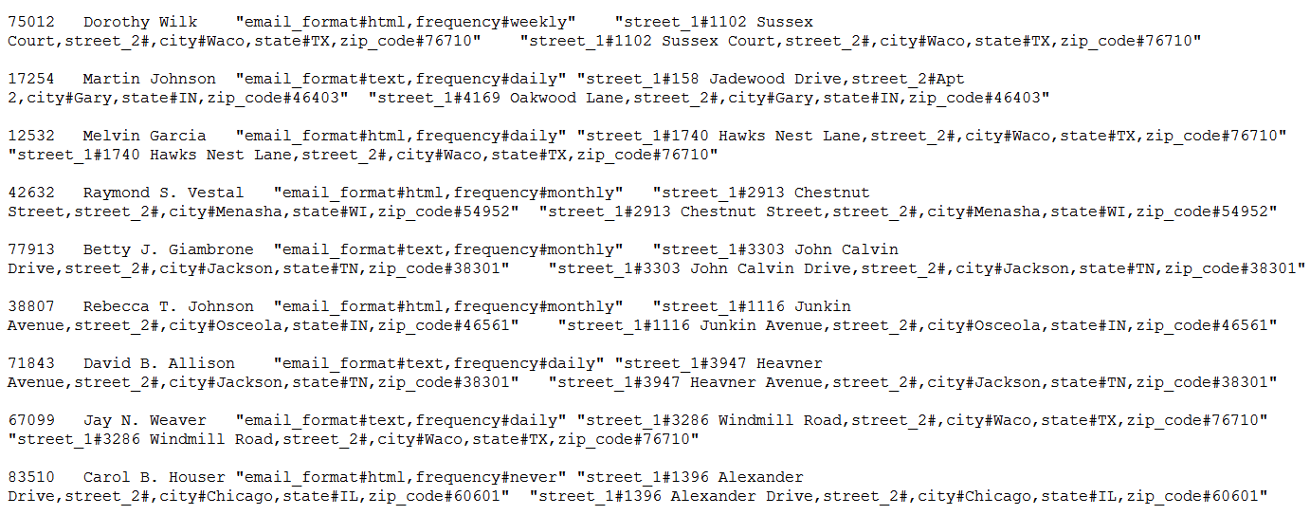
HBase – Sample ‘Customer’ data File
This is a tab separated file
customers_address_hbase.txt

Slide 61
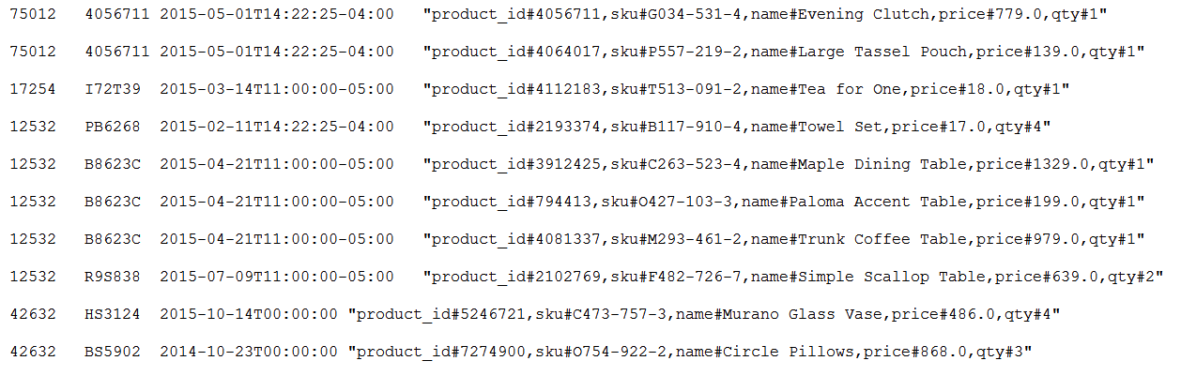
Hbase – Sample ‘Orders’ data file
customers_orders_hbase.txt

Slide 62
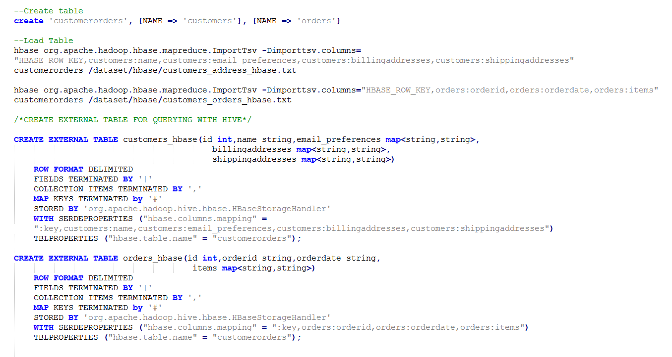
Create, Load, Query HBase Tables
HBase supports Hive queries – Hive queries from previous slides can be run directly on these HBase tables.

Slide 63
HBase as a platform
Running on top of HBase using it as a datastore
Phoenix
Kiji
Titan
Phoenix
Titan
Continuity
OpenTSDB
Continuity
Splice Machine
Kiji
OpenTSDB
Splice Machine
Integrated with HBase
Hive
Solr
Storm
Impala
Spark
HBase
Drill
Pig
Flume
Ganglia
Hive
Solr
Storm
Impala
Spark
Drill
Pig
Flume
Ganglia

Slide 64
When to use HBase in Azure
Existing expertise or workload on HBase
Storing large amounts of data
Need high write throughput
Need efficient random access within large dataset
Need to scale gracefully with data
For structured and semi-structured data
Don’t need full RDBMS capabilities (cross table transactions, joins)

Slide 65
HBase and RDBMS
 | RDBMS | HBase
Data Layout | Row oriented | Column Oriented
Transactions | ACID over multiple rows and tables | ACID over single row or adjacent row groups only
Query language | SQL | None (APIs: get, put, scan, … )
Joins | Yes | No
Indexes | On any column or multiple columns | Single row index only
Data Size | Usually limited to Terabytes | Petabytes

Slide 66
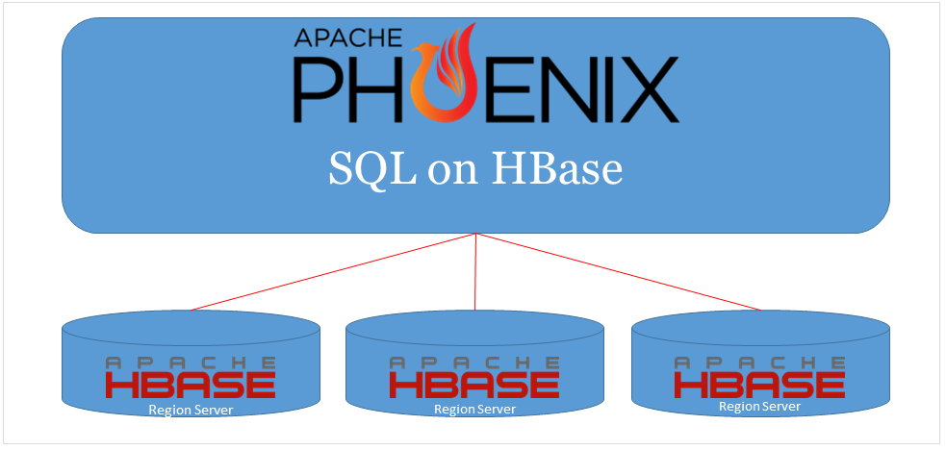
Apache Phoenix —SQL over HBase
Apache Phoenix is a relational database layer on top of HBase.
Lets you view HBase table as regular relational tables (Rows and Columns). Maps the HBase data model to the relational data model.
Lets you query HBase tables using SQL
Creates a scale-out relational database using HBase.
Integrates with the Hadoop ecosystem (Pig, Scoop, Flume)
Requires no additional servers

Slide 67
Apache Phoenix: SQL Support
SQL Language Construct | Supported? (Yes/No)
CREATE/DROP/ALTER TABLE | Yes
UPSERT / DELETE | Yes
SELECT | Yes
WHERE / HAVING | Yes
GROUP BY / ORDER BY | Yes
LIMIT | Yes
JOIN | Yes (with limitations)
VIEWS | Yes
Transactions | No

Slide 68
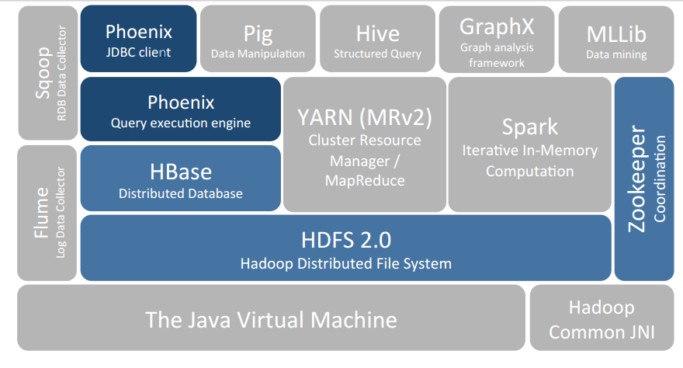
Apache Phoenix: Components
Query Execution Engine
Transforms SQL queries into native HBase API calls
Pushes down operations onto the cluster for maximum parallelism
JDBC Driver
Client side driver
Metadata Repository
Provides typed access to data stored on HBase tables

Slide 69
Apache Storm
What is Storm
Developing Storm Applications
Bolts, Spouts and Topologies
Trident
Trident and Storm
Storm on HDInsight

Slide 70



Apache Storm: What is it?
Use cases:
Streaming data analysis
Distributed RPC
Continuous Computation
Easy to program
Hides complexity of distributing computing
Fast
Clocked at 1M+ messages per second per node
Scalable
Scale with the nodes of a cluster.
Fault Tolerant
Resilient to node and software failure
Reliable
Guaranteed at least-once semantics

Slide 71



Apache Storm and Event Hubs
Event producers
Collection
Event Queuing System
Transformation
Long-term storage
Presentation and action
Live Dashboards
Azure ML
Web/thick client dashboards
Applications
Apache Storm on HDInsight
Apache HBase on
HDInsight
Search and query
Devices
Cloud gateways (web APIs)
Event hubs
DocumentDB
Solr Azure Search
MongoDB SQL
Data analytics (Excel)
Sensors
Kafka/RabbitMQ/
ActiveMQ
Storage adapters
Field gateways
Stream processing
Event hub
Web and social
Devices to take action

Slide 72

Storm Application in 5 steps
Create a Storm cluster
Write one or more Spouts
Write one or more Bolts
Create a Topology
Launch the Topology
A cluster consists of one or more Zookeeper and Supervisor nodes
A Spout is
a program that consumes data from a source and emits tuples
Bolt is a processing step in a pipeline that consumes & emit tuples from/to other Bolts/Spouts
Wire the Spouts and Bolts to create a network
Storm will distribute the Topology code to all the nodes of the cluster and start the Spouts and Bolts

Slide 73
Storm Daemons
Nimbus
Similar to Hadoop JobTracker. Responsible for:
distributing code around the cluster
assigning tasks to machines
monitoring for failures
Zookeeper
Used for cluster coordination
Use multiple nodes for failover and scale
Stateless—can be restarted quickly. Fails over quickly
ZooKeeper
Nimbus
ZooKeeper
Supervisors
ZooKeeper
Supervisor
Listens for work assigned to its machine and starts and stops worker processes based on directives from Nimbus. Each worker process executes a subset of a topology
User’s application logic (Spouts and Bolt) run here.
Stateless—can be restarted quickly. Fails over quickly.

Slide 74
Concept: Storm Spouts
Spouts are a source of streams in a topology. A topology starts with one or more spouts.
The main method on spouts is nextTuple(). nextTuple() either emits a new tuple into the topology or simply returns if there are no new tuples to emit.
Spouts must implement the IRichSpout()interface
A reliable spout is one which can reemit a tuple if necessary (e.g. failure during processing)
Each spout or bolt execute as many tasks across the cluster.
Each task corresponds to one thread of execution
Stream groupings define how to send tuples from one set of tasks to another set of tasks.
You can set the parallelism for each spout or bolt
Kafka
Spouts are available for most popular Stream sources
Azure Event Hubs
{…}
{…}
{…}
Amazon Kinesis
{…}
{…}
{…}
IBM MQ
File
A Spout can generate multiple streams.
Popular Stream Sources

Slide 75
Concept: Storm Bolts
Storm topology is a sequence of transformations on the input stream. A Bolt implements one transformation.
A Bolt implements a callback function (‘execute’ method on IRichBolt interface)—containing the application logic—which is executed by Storm.
Bolt receives a stream of events—from other Bolts or Spouts—transforms it and emits an output stream. Transformations include: filtering, aggregation or other functions.
Bolts can ‘join’ multiple input stream or ‘split’ a single stream into multiple output streams.
During execution, a Bolt can store or read state from a database or any state stored in the Zookeeper node.
{…}
{…}
{…}
{…}
{…}
{…}
One-to-one Transformation
{…}
{…}
{…}
{…}
{…}
{…}
{…}
{…}
Join Transformation
{…}
{…}
{…}
{…}
{…}
{…}
{…}
{…}
{…}
Split
Transformation
{…}

Slide 76
Stream groupings
For Bolts with multiple tasks executing in parallel in a cluster, Stream Grouping determine how tuples should be partitioned between them
Stream Grouping | Description
Shuffle | Sends tuples to bolts in random, round robin sequence
Fields | Sends tuples to a bolt based on one or more fields in the tuple
All | Sends a single copy of each tuple to all instances of a receiving bolt
Custom | Route tuples based on factors such as data types, load, and seasonality.
Global | Sends tuples generated by all instances of a source to a single target instance
Local or shuffle grouping | If the target bolt has one or more tasks in the same worker process, tuples will be shuffled to just those in-process tasks. Otherwise, acts like a normal shuffle grouping.
Direct Grouping | The producer of the tuple decides which task of the consumer will receive this tuple. Can only be declared on streams that have been declared as direct streams.
Partial Key Grouping | Same as Field grouping, but are load balanced between two downstream bolts, which provides better utilization of resources when the incoming data is skewed
Tasks
?
?
{…}
?

Slide 77
At-least-once Message Processing
At-most-once message processing can be achieved with no additional coding
A tuple coming off a spout can trigger thousands of tuples to be created based on it, creating a ‘tree’ of tuples.
Storm considers a tuple coming off a spout "fully processed" when the tuple tree has been exhausted and every message in the tree has been processed within the specified time.
Storm will remember the entire tree of tuples efficiently until the tree is processed.
If all the ACKs are not received within the specified timeout, Storm will ask the Spout to re-emit the tuples (replay).
For at-least-once processing the following additional 3 things must be done:
When spouts emit tuples, they must specify a unique message ID. Spout implementation, like storm-kafka or storm-kestrel, do this automatically for you.
When bolts emit tuples, they must anchor them with input tuples.
When bolts are done processing the input tuple, they must ‘ack’ or ‘fail’ the input tuple
Note, for exactly-once processing, use the Trident framework
Tree of Tuples
{…}
{…}
{…}
{…}
{…}
{…}
{…}
{…}
{…}
Acker
Ack
Ack
Ack

Slide 78
Apache Trident: What is it?
A higher-level framework built on top of Apache Storm for increased developer productivity
Is a batch-oriented streaming analytic framework (like Pig or Cascading)
Rather than emitting a single event, Spout emits tuples in batches.
Size of the batches can be controlled.
Bolts process tuples in batches.
Provides a number of built-in operators that work on a batch:
Join and Merge
Aggregate, persistentAggregate
groupBy
Repartition and Partition Local operators
Trident topologies compile to Storm topologies
Supports exactly-once message processing
Trident persists state in a way so that if failures occur and retries are necessary, it won't perform multiple updates to the database for the same source data.
State can be persisted correctly even when tuples are replayed on failure.
Code for counting words in an input stream.
FixedBatchSpout spout = new FixedBatchSpout(new
Fields("sentence"), 3, new Values("cow jumped over the moon");
TridentTopology topology = new TridentTopology();
TridentState wordCounts = topology.newStream("spout1", spout)
.each(new Fields("sentence"), new Split(), new Fields("word"))
.groupBy(new Fields("word"))
.persistentAggregate(new MemoryMapState.Factory(),
new Count(), new Fields("count"));
What the code does:
Takes a stream of text from a Spout
Split the text into words
Groups the words
Stores the word and count of words to an in-memory store

Slide 79
Trident and Storm
 | Storm | Trident
Productivity API | Very low level. No built-in operators | Higher level Abstractions. Many built-in operators Trident sometimes needs multiple orders of magnitude less lines of code compared to Storm for the same application logic
Windowing Support | Can roll your own tumbling windows with tick tuples. No supports for sliding window | No tick tuple feature so no windowing support of any type
At-least-once Guarantee | Yes, if the ‘reliability API’ is used and with spouts that can re-emit tuples when requested | Yes, with spouts that can re-emit tuples when requested.
Exactly-once Guarantee | No | Yes, with suitable spouts. Trident has support for storing data in an external store only-once even when tuples are ‘replayed’

Slide 80
Apache Storm on HDInsight
Managed services
Event Hub
Open source platform
Visual Studio
Analyse millions of messages per second
Azure
Scale-up and scale-down
HBase, SQL Database, DocumentDB
Speed
Notes:
Provide Open source Apache Storm as a fully managed service
SLA of 99.9% up time
Build analytics pipeline on industry leading open source platform
Examples of some of the companies running on Apache Storm: https://storm.apache.org/documentation/Powered-By.html
Analyze millions of messages per second
HDInsight team runs a lab test that processes 1 million messages per second ingested from Eventhub
Built in Scale-up & Scale-down features
Customers can scale up and scale down a running cluster; with no impact to a running topology
Deep integration with Event hub
Program your Storm Topology in Java or C#
Enabled a first class support for writing topologies in C#
We have taken ease of programming to the next level by enabling mixed mode topologies, which means you can take an existing Spout written in Java but build the rest of the topology in C#.
The Storm service also comes with the Trident support.
Full integration with Visual Studio (click through experience captured in attached email)
Fully integrated Azure AUX experience (click through experience captured in attached email)
Write your data into HBase, SQL Azure, DocumentDB

Slide 81
Visual Studio tooling
You can develop and deploy Storm applications completely from within Visual Studio
Create Storm projects from available template
Submit a topology with C# bolts/spouts
Submit Topologies containing Java spouts/bolts
Monitor Topologies within VS
Troubleshoot Topologies

Slide 82

Apache Kafka on HDInsight

Slide 83



Event ingestion patterns
Event processing
Stream processing
Business apps
Azure
Stream Analytics
Azure Event Hubs
Power BI
Events
Events
Storm
Events
Custom apps
HDInsight
Kafka
Spark Streaming
ADLS
Sensors and devices
Notes:
COMPLETES THE OPEN SOURCE STACK FOR STREAMING ON HDINSIGHT
Working with Top automobile companies to enable IoT scenarios
Kafka vs EventHubs
-- Open source support
-- Highly achieveable throughput with a small number of nodes

Slide 84
What is Apache Kafka?
Apache Kafka is a High throughput, low-latency message queueing service
Developed at LinkedIn, now a project part of Apache
It uses a simple Publish-Subscribe messaging model. Much like Dish subscribers
The architecture is very robust and scalable. Data is partitioned, replicated across the whole cluster
It scales linearly as throughput needs increase. Just add more storage
It is often used to build real-time ingestion pipelines

Slide 85

Kafka Architecture
Kafka ecosystem
Consumer group
Kafka cluster
Producer 1
Broker 1
Consumer 1
Producer 2
Push msg
Broker 2
Pull msg
Consumer 2
Producer 3
Broker 3
Consumer 3
Get Kafka broker ID
Update offset
ZooKeeper
Notes:
Two major components: Zookeeper and broker nodes
How does it get used? Producers
Producers are sensors (mobile devices, etc.), which create events for it. Then they send it to the Kafka ecosystem
Once they have a Kafka broker id, then it gets pushed in the Kafka cluster
Kafka buffers all that data, then zookeeper manager

Slide 86
Kafka Architecture
Topics
Kafka brokers
Leader
Read data
Write data
Consumer group
0 1
Server 1
P1
Replica 1
Consumer 1
Producer 1
Follower
0 1 2 3
Server 2
Consumer 2
P2
Replica 2
Producer 2
Follower
Consumer 3
0
Server 3
P3
Replica 3
Notes:
Key points to mention
TOPICS – Dish TV Subscriber analogy. Topic is a HBO + Channel subscription, Dish is producer, you are consumer
Kafka is replicated to provide data reliablility
Kafka has leader follower for high avaiabiility
Kafka is partitioned for parallel processing
Put all of these together, we have High throughput, low latency that scales out elegantly without performance hits.
Put this on HDI – you don’t have to worry about broker management, or Kafka service. We do it for you.

Slide 87
Why HDInsight Kafka
How should business intelligence owners think about building data architectures?
Where does HDInsight fit in to this?
Where does Kafka fit in, and how should I use it?

Slide 88
Kafka on HDI benefits
Reduced cost of ownership
HDInsight is a fully managed service with 99.9% SLA. We provide a SLA for the end to end service, not just VM instances. This greatly reduces the cost to implement, configure, and monitor Kafka components. 63% lower TCO than on-premises. IDC study “The Business Value and TCO Advantage of Apache Hadoop in the Cloud with Microsoft Azure HDInsight”
Broker Management, ensure they are always running
Rack awareness for Kafka
Installation, configuration, and certification of open source components

Slide 89
Kafka on HDI benefits
Security & Compliance
HDInsight is an enterprise level service built on Azure.
Every customer benefits from the compliance features that Azure has to offer.
In addition to this, HDInsight has introduced new security features such as HIPAA compliance, Active Directory authentication, SSH based access, Apache Ranger support, and more.

Slide 90
Kafka on HDI benefits
Enterprise grade Alerting and Monitoring
HDInsight Kafka has native integration with Azure Operations Management Suite (OMS)
Monitor all of your resources from the Azure Portal
Collect, search, analyze Hadoop Logs + JMX Metrics
Set alerts, take predictive actions with Azure Automation Runbooks
Leverage pre-built visualizations, or build custom ones to fit your business needs

Slide 91
HDInsight Kafka availability
Currently incubating
Limited Preview Mid-November
Public Preview Mid-February, General Availability shortly after
Public Preview will feature significant cost reductions as workloads scale.
Notes:
I generally don’t mention managed disks until cost reduction.
Once the customer is interested in Kafka, we learn about their architecture, then mention managed disks.
If they want to onboard pre-public preview, then we have to ensure that they are aware of the assisted migration that will take place
This migration has zero data loss, and zero downtime. Can share migration plan if needed.

Slide 92



Enablement
Event producers
Collection
Event queuing system
Transformation
Long-term storage
Presentation and action
Web/thick client dashboards
Azure ML
Live Dashboards
Applications
HDInsight
Apache HBase on
HDInsight
Search and query
Devices
Cloud gateways (web APIs)
Event hubs
DocumentDB
Solr Azure Search
MongoDB SQL
Sensors
HDInsight Kafka
Data analytics (Excel)
Field gateways
Storage adapters
Event hub
Web and social
Devices to take action
Stream processing
Notes:
Providing managed Kafka, Storm, Spark, services enables you to use them as building blocks to architect a powerful streaming solution

Slide 93
Choosing a ingestion technology
 | Kafka | Azure event hubs
Managed | Yes | Yes
Ordering | Yes | Yes
Delivery | At-least-once | At-least-once
Lifetime | Configurable | 1–30 Days
Replication | Configurable within region | Yes
Throughput | *nodes | 20 throughput units
Parallel clients | Yes | No
MapReduce | Yes | No
Record size | Configurable | 256K
Cost | Low | Medium – High as scaled out
Notes:
Use this slide with caution
Kafka vs Azure Event Hubs Customers would use these technologies as complementary services. That being said, comparing these technologies is not an apples to apples comparison.
* Performance Kafka for HDinsight’s architecture is very simple and elegant allowing for scaling to million+ events/sec with small to large message sizes and a large throughput of the system (hunders of MBps). Azure Event Hubs on the other hand is a multi-tenant managed Azure service. Due to this multi-tenant nature, Azure Event Hubs throttles the users in some metrics. For ex. It can provide upto 1Mbps/ throughput unit, max 20 TUs. Another example of this is the message size limitation f 256 KB.
* Developer ecosystem Kafka for HDInsight is part of the extensive open source offering that is built on top of Azure for enabling Big Data Solutions. There already exists a rich developer ecosystem for these open source technologies. For ex. If a user has an issue using Kafka, they can quickly search on StackOverflow and get the answer in seconds. For EventHubs, Microsoft support needs to be contacted.
* Ease of use While Kafka exposes a very simple API, there is still cluster management involved. EventHubs on the other hand do not need a cluster to be managed which might be easier to get started. While the note about performance was made earlier, EventHubs can handle million events/second – to get started, this might not be a bad choice.

Slide 94
Choosing a streaming technology
 | Azure Stream Analytics | Storm | Spark Streaming
Managed | Yes | Yes | Yes
Temporal operators | Windowed aggregates, and temporal joins are supported out of the box | Temporal operators must to be implemented | Temporal operators must to be implemented
Development experience | Interactive authoring and debugging experience through Azure Portal | Visual Studio, etc. | Visual Studio, etc.
Data encoding formats | Stream Analytics requires UTF-8 data format to be utilized | Any data encoding format may be implemented via custom code | Any data encoding format may be implemented via custom code
Scalability | Number of Streaming Units for each job. Each Streaming Unit processes up to 1MB/s. Max of 50 units by default. Call to increase limit | Number of nodes in the HDI Storm cluster. No limit on number of nodes (Top limit defined by your Azure quota). Call to increase limit | Number of nodes in the HDI Spark cluster. No limit on number of nodes (Top limit defined by your Azure quota). Call to increase limit
Data processing limits | Users can scale up or down number of Streaming Units to increase data processing or optimize costs Scale up to 1 GB/s | User can scale up or down cluster size to meet needs | User can scale up or down cluster size to meet needs.
Late arrival and out of order event handling | Built-in configurable policies to reorder, drop events or adjust event time | User must implement logic to handle this scenario | User must implement logic to handle this scenario

Slide 95
Get started today!
For more information visit: http://azure.microsoft.com/en-us/services/hdinsight/

